Slide 1

Predicting Rossmann Store Sales

Slide 2

Agenda
Rossmann Store Sales Task Introduction
Data Preprocessing
Linear Regression with XGBoost Implementation
Predicting Daily Sales of 6 Weeks in Advance
Conclusion

Slide 3

Rossmann Store Sales Task
Rossmann Store Introduction:
Rossmann operates over 3,000 drug stores in 7 European countries.
Store sales are influenced by many factors, including promotions, competition, school and state holidays, seasonality, and locality.
There are 1,115 stores located across Germany.
Task:
Helping Rossmann create a robust prediction model and predict 6 weeks of daily sales for 1,115 stores located across Germany. Help store managers to create effective staff schedules that increase productivity and motivation.

Slide 4

Data Preprocessing
“Data cleaning is the number one problem in data warehousing”
—DCI survey

Slide 5
Data Preprocessing
Store
Customers
ID
Sales
Open
StateHoliday
Storetype
SchoolHoliday
Data Dictionary
Data Cleaning
Data Reduction
Sampling
Dimensionality Reduction
Data Transformation
Discretization and Binarization
Error
CompetitionDistance
Assortment
CompetitionOpenSince[Month/Year]
Promo2
Promo
Promo2Since[Year/Week]
PromoInterval
Notes:
Id - an Id that represents a (Store, Date) duple within the test set
Store - a unique Id for each store
Sales - the turnover for any given day (this is what you are predicting)
Customers - the number of customers on a given day
Open - an indicator for whether the store was open: 0 = closed, 1 = open
StateHoliday - indicates a state holiday. Normally all stores, with few exceptions, are closed on state holidays. Note that all schools are closed on public holidays and weekends. a = public holiday, b = Easter holiday, c = Christmas, 0 = None
SchoolHoliday - indicates if the (Store, Date) was affected by the closure of public schools
StoreType - differentiates between 4 different store models: a, b, c, d
Assortment - describes an assortment level: a = basic, b = extra, c = extended
CompetitionDistance - distance in meters to the nearest competitor store
CompetitionOpenSince[Month/Year] - gives the approximate year and month of the time the nearest competitor was opened
Promo - indicates whether a store is running a promo on that day
Promo2 - Promo2 is a continuing and consecutive promotion for some stores: 0 = store is not participating, 1 = store is participating
Promo2Since[Year/Week] - describes the year and calendar week when the store started participating in Promo2
PromoInterval - describes the consecutive intervals Promo2 is started, naming the months the promotion is started anew. E.g. "Feb,May,Aug,Nov" means each round starts in February, May, August, November of any given year for that store
Data pre-processing is the very first thing that should be done before performing data analysis.
Redundant, noisy or unreliable data will make knowledge discovery during training phase much more difficult.
The data dictionary plays an important role in helping us determine the actual value of a particular feature/dimension.
We know that in the case of this particular problem, it is mostly a multiple regression problem where multiple independent variable will affect a dependant variable.
Ideally that should be the case but, there is also a chance where different independent variables will affect one another as well.

Slide 6
Data Preprocessing
Data Cleaning
Set missing value to default value
Delete rows for Open = 0
Remove outlier, std > 4𝜎
Data Reduction
Reduce the number of attributes
Only use data sets that are relevant for analysis
When attribute ‘Sales’ > 0 the ‘Open’ attribute is true
Data Dictionary
Data Cleaning
Data Reduction
Sampling
Dimensionality Reduction
Data Transformation
Discretization and Binarization
Error
Notes:
Data Cleaning
Probably the first and most important step to easier knowledge discovery
Data Aggregation
Reducing the number features/attributes helps in reducing the curse of dimensionality.

Slide 7
Data Preprocessing
Sampling
90% for model training
9% for model testing
1% for model validation
Dimensionality Reduction
To reduce the resources required for algorithm (e.g. PromoInterval)
Remove irrelevant or low impact features
Data Dictionary
Data Cleaning
Data Reduction
Sampling
Dimensionality Reduction
Data Transformation
Discretization and Binarization
Error
Notes:
PromoInterval - describes the consecutive intervals Promo2 is started, naming the months the promotion is started anew. E.g. "Feb,May,Aug,Nov" means each round starts in February, May, August, November of any given year for that store

Slide 8
Data Preprocessing
Data Transformation
Date → Year, Month, Day, DayOfWeek, WeekOfYear
Discretization and Binarization
Not Used
Error
Use Root Mean Square Percentage Error
Data Dictionary
Data Cleaning
Data Reduction
Sampling
Dimensionality Reduction
Data Transformation
Discretization and Binarization
Error
Notes:
Feature Creation
Allows data to be more accurately represented.

Slide 9
Model Training

Slide 10

Linear Regression is most suitable for this data
Open-source software library provides the gradient boosting framework for different languages.
implementation of gradient boosted decision trees designed for speed and performance.
Linear Regression With XGBoost
Why?

Slide 11
Optimum Parameter
Gradient Boost Parameter
Objective | Linear Regression
Booster | gbtree
Learning | 0.3
Max Depth | 10
Column Sample By Tree | 0.7
Maximum Iteration | 300
Early Stopping Rounds | 50
Notes:
Booster which booster to use, can be gbtree, gblinear or dart. gbtree and dart use tree based model while gblinear uses linear function.
Learning Rate means step size shrinkage used in update to prevents overfitting. After each boosting step, we can directly get the weights of new features. and eta actually shrinks the feature weights to make the boosting process more conservative.
Max Depth means maximum depth of a tree, increase this value will make the model more complex / likely to be overfitting.
Column Sample By Tree subsample ratio of columns when constructing each tree.
Maximum Iteration corresponds to the time the gradient boosting algorithm runs
For Early Stopping Rounds it means if the accuracy did not increases after 50 rounds. The training will terminate automatically

Slide 12
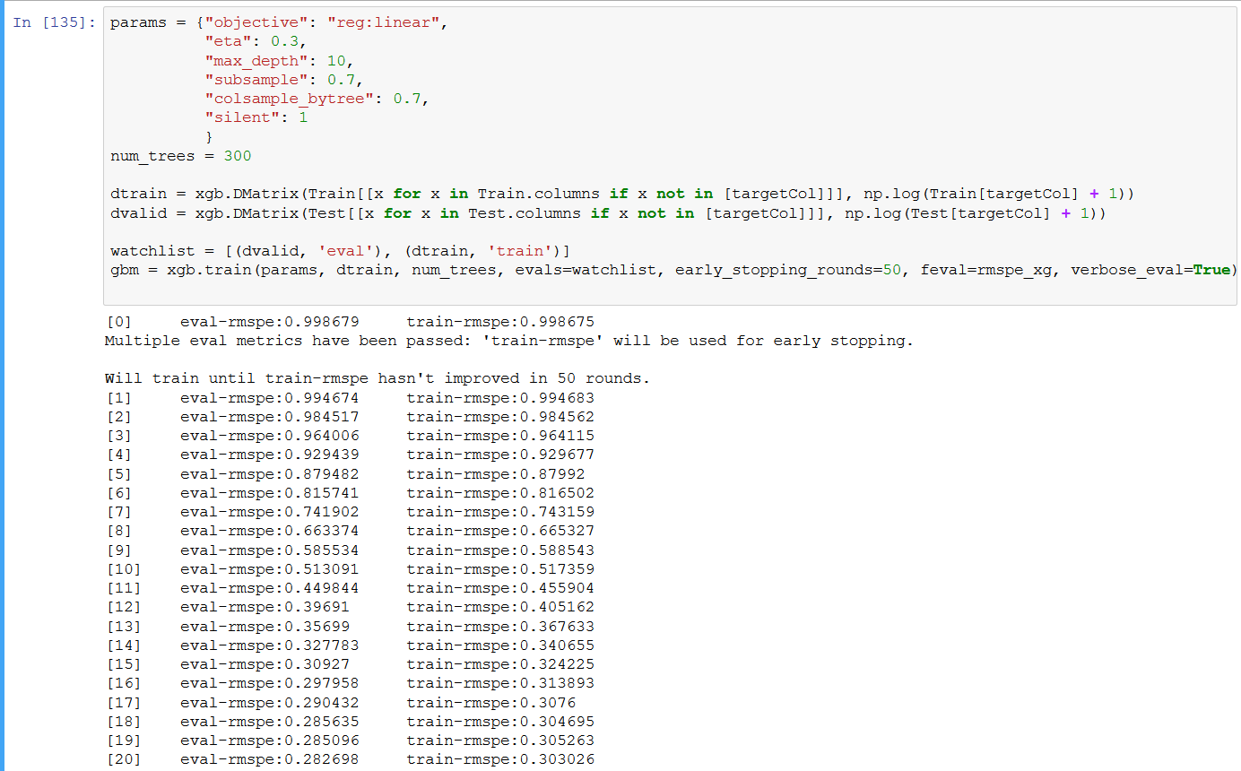
Training
Notes:
Top portion is XGB Parameter
The next two are to package the training data and testing into DMatrix
Watchlist for XGB to determine the best iteration and for user to see how the error parcentage is increasing for each iteration
So in the watch list we are using RMSPE. Which is Root Means Square Percentage Error. You might wonder why?

Slide 13
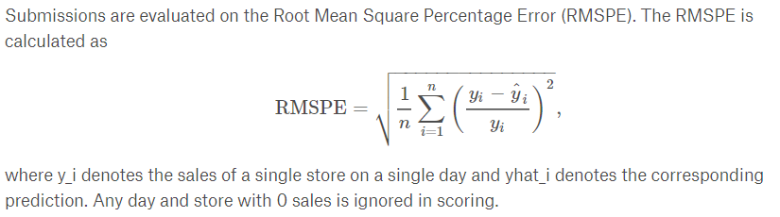
Root Mean Square Percentage Error
Notes:
It is due to the competition requirement, the submission will be evaluated on RMSPE
RMSPE is the Root Mean Square of the error of exact y and predicted y

Slide 14
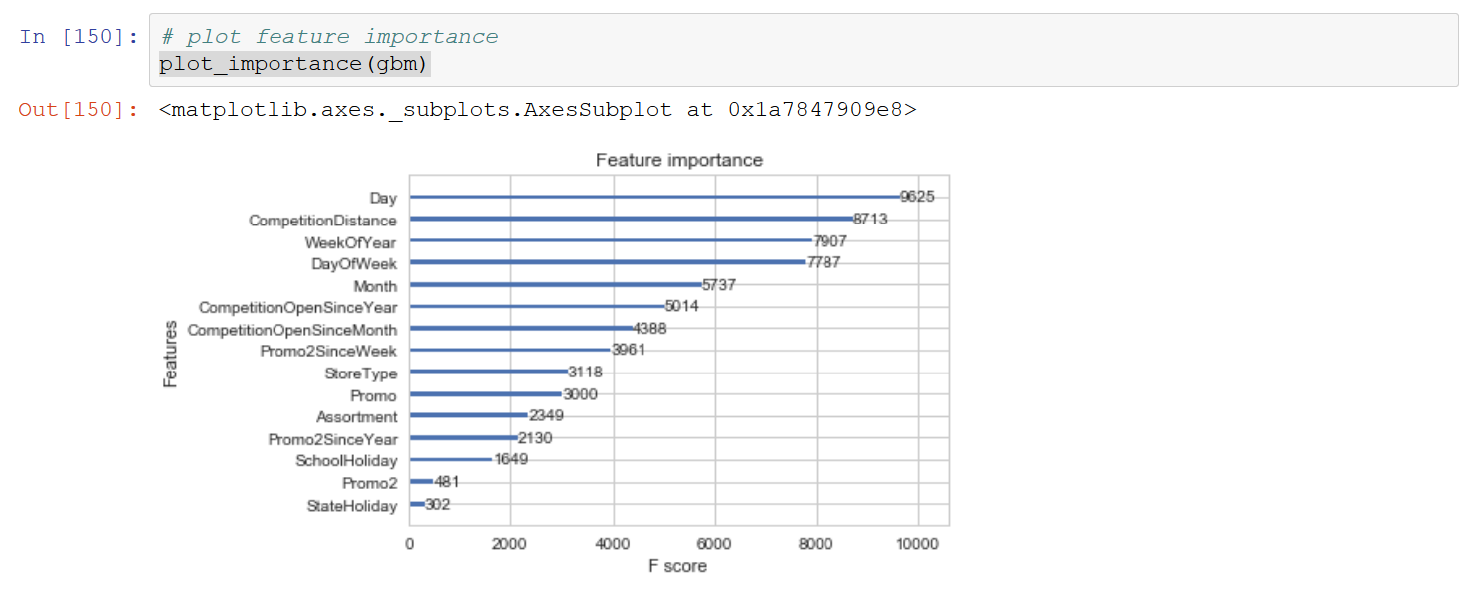
Importance Map
Notes:
Importance provides a score that indicates how useful or valuable each feature was in the construction of the boosted decision trees within the model. The more an attribute is used to make key decisions with decision trees, the higher its relative importance.This importance is calculated explicitly for each attribute in the dataset, allowing attributes to be ranked and compared to each other.

Slide 15
Prediction

Slide 16
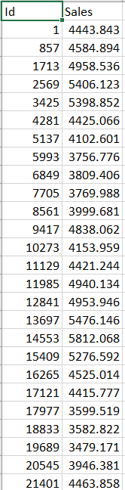
Prediction
Notes:
Importance provides a score that indicates how useful or valuable each feature was in the construction of the boosted decision trees within the model. The more an attribute is used to make key decisions with decision trees, the higher its relative importance.This importance is calculated explicitly for each attribute in the dataset, allowing attributes to be ranked and compared to each other.

Slide 17
Conclusion

Slide 18

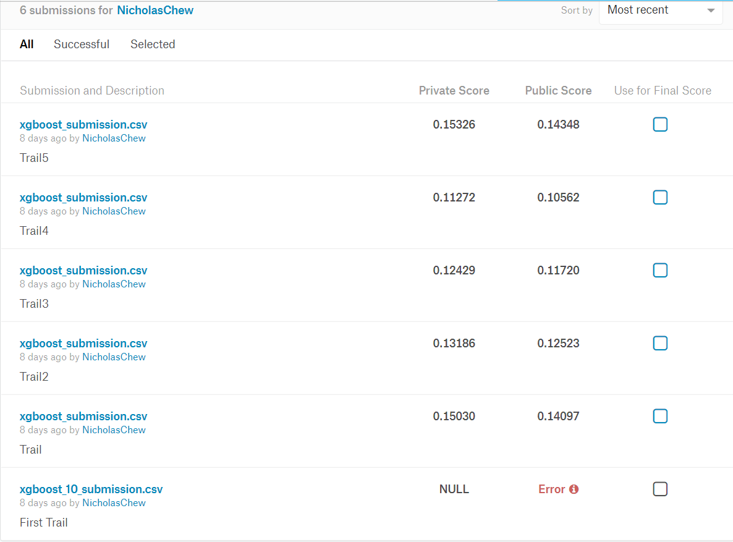
TOP 3%
Whoa! That’s a big number, aren’t you proud?
Notes:
We got 0.11272 for private Score which is 11.272% error.
We are only looking
The private leaderboard is calculated with approximately 61% of the test data.
This leaderboard is calculated with approximately 39% of the test data.
The final results will be based on the other 61%, so the final standings may be different.

Slide 19
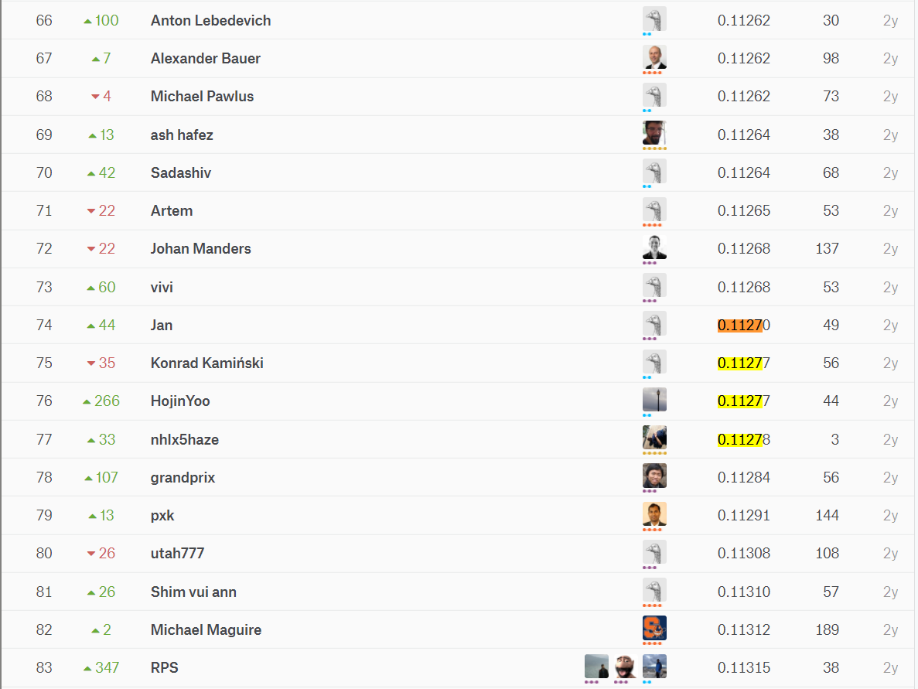
TOP 3%
Whoa! That’s a big number, aren’t you proud?
Notes:
With 11.272% error, we got on to placing number 75

Slide 20
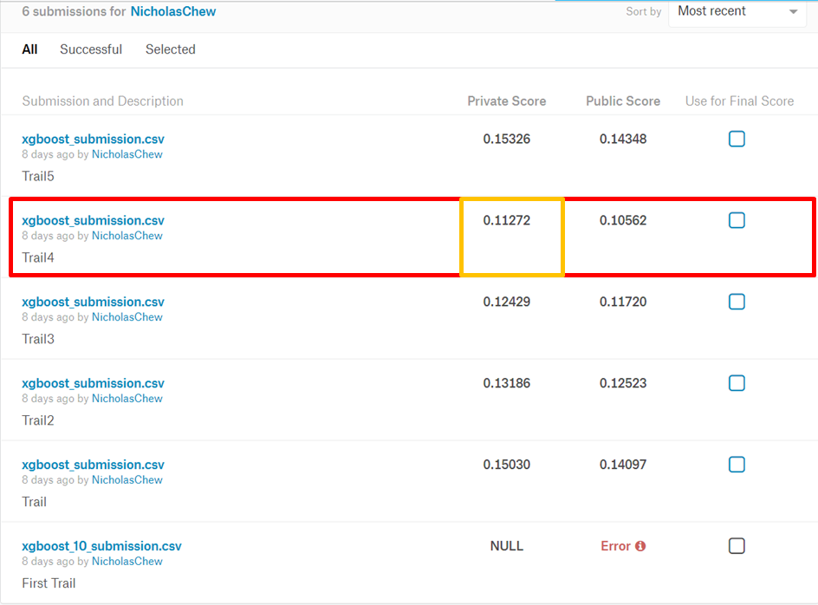
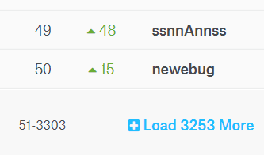
TOP 3%
Whoa! That’s a big number, aren’t you proud?
Notes:
Out of 3303 participant

Slide 21
TOP 3%
Whoa! That’s a big number, aren’t you proud?
Notes:
which is within the top 3%

Slide 22

“WHEN IN DOUBT, USE XGBOOST”
Avito Winner' 1st place, Owen Zhang
Notes:
Lastly, According to one of the Winner on the Kaggle website, WHEN IN DOUBT, USE XGBOOST.

Slide 23

Thank You
Notes:
Thanks

